Slide 1
MLDS 2017 Spring
HW3 - Generative Adversarial Networks
mldsntu2017@gmail.com

Slide 2
Outline
Task Introduction
Text2image generation
Dataset collection
Model
Conditional GAN
Tips for training
Discriminator loss function
Objective function
Submission and grading

Slide 3
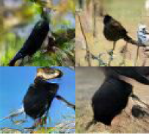
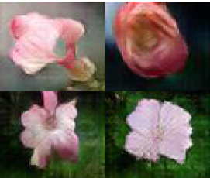
Task Introduction - text2image generation
Bird
Generative Model
an all black bird
this flower is
white and pink
Flower Generative Model

Slide 4


Task Introduction - text2image generation
a man with no hair
and one red strong fist
Anime Generative Model
a girl with blue hair, blue eyes and
twin ponytail

Slide 5
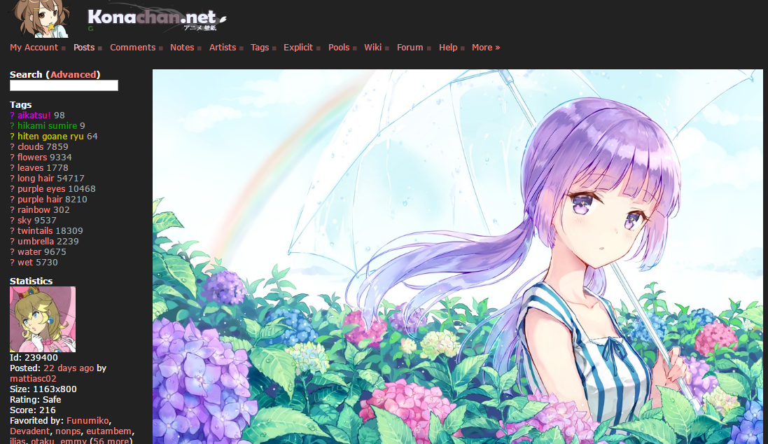
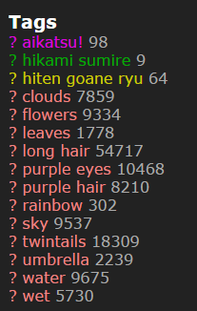
Data Collection
Not all tags are useful
http://konachan.net/post/show/239400/aikatsu-clouds-flowers-hikami_sumire-hiten_goane_r
感謝樊恩宇助教蒐集data

Slide 6
Model and training tips

Slide 7
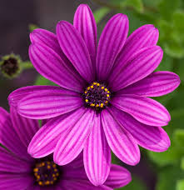
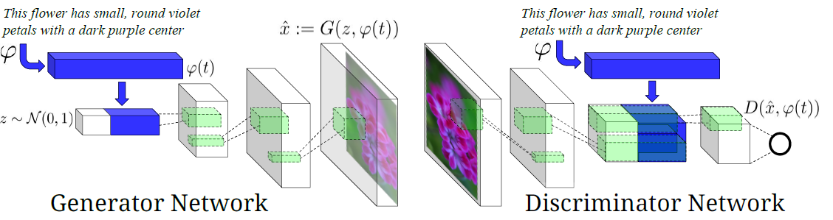
Conditional GAN for text2image generation
real img
linear transform
(noise_dim+text_dim)
(4, 4, channel_dim+text_dim)
fake img
Paper: https://arxiv.org/pdf/1605.05396.pdf

Slide 8
Details for training
Updates between Generator and Discriminator
1 : 1 or 2 : 1
ADAM with lr = 0.0002, momentum = 0.5
gaussian or uniform noise dim = 100
batch size = 64
epoch = 600
Practically, epoch = 300 is enough

Slide 9
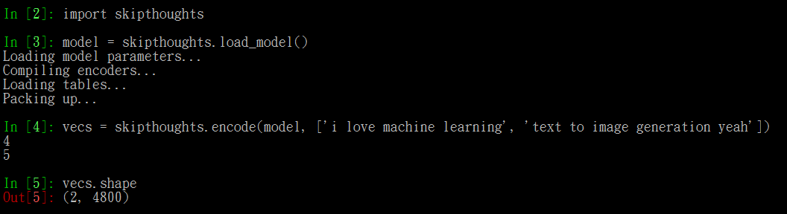
Text feature process tool - Skip-thought vector
No matter which tool you use to process text input, please make sure you include that pre-trained model in your repository to let us run your code successfully.
skip-thought source code: https://github.com/ryankiros/skip-thoughts

Slide 10
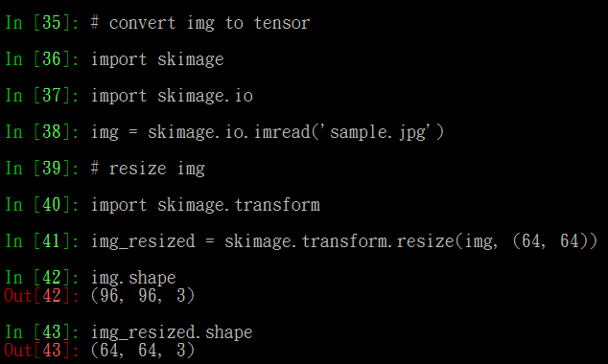
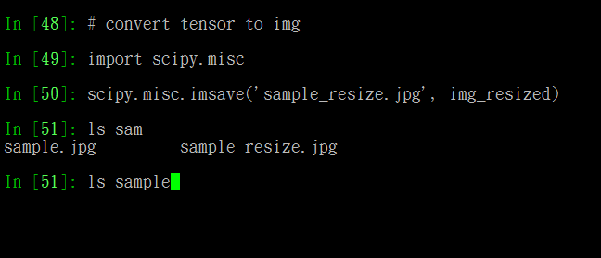
Image process tool - skimage and scipy.misc
Install:
sudo apt-get install python-skimage
sudo pip install --user numpy scipy

Slide 11
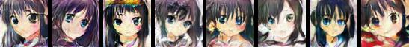

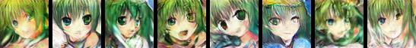

Little Demo
input text: black hair blue eyes
input text: pink hair green eyes
input text: green hair green eyes
input text: blue hair red eyes

Slide 12
Tips for training
Discriminator output:
(real img, right text): 1
(fake img, right text): 0
(real img, wrong text): 0
(wrong img, right text): 0
Different objective function
Wasserstein GAN (WGAN)
Least Squares GAN (LSGAN)
Boundary-Seeking GAN (BGAN)

Slide 13
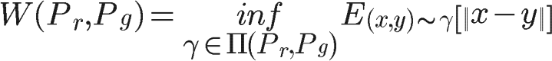
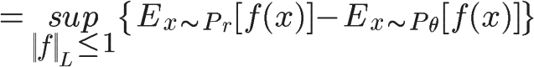


Wasserstein GAN
Earth-Mover (Wasserstain-1) distance
The optimization problem is thus :
EM distance is Continuous
JS-divergence is not
Reference : Arjovsky, Martin, Soumith Chintala, and Léon Bottou. "Wasserstein gan." arXiv preprint arXiv:1701.07875 (2017).

Slide 14

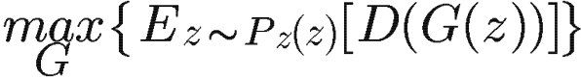
Wasserstein GAN
For Discriminator
For Generator
The output of D is thus not probability anymore !
The D loss turn to be a measure of distance

Slide 15
Wasserstein GAN
Implementation Notes :
Do not apply sigmoid at the output of D
Clip the weight of D
Use RMSProp instead of Adam
Train more iteration of D (the paper use 5)

Slide 16

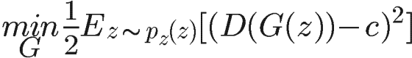
Least Squares GAN
For Discriminator
For Generator
1
-1
0
Reference: Mao, Xudong, et al. "Least squares generative adversarial networks." arXiv preprint ArXiv:1611.04076 (2016).

Slide 17
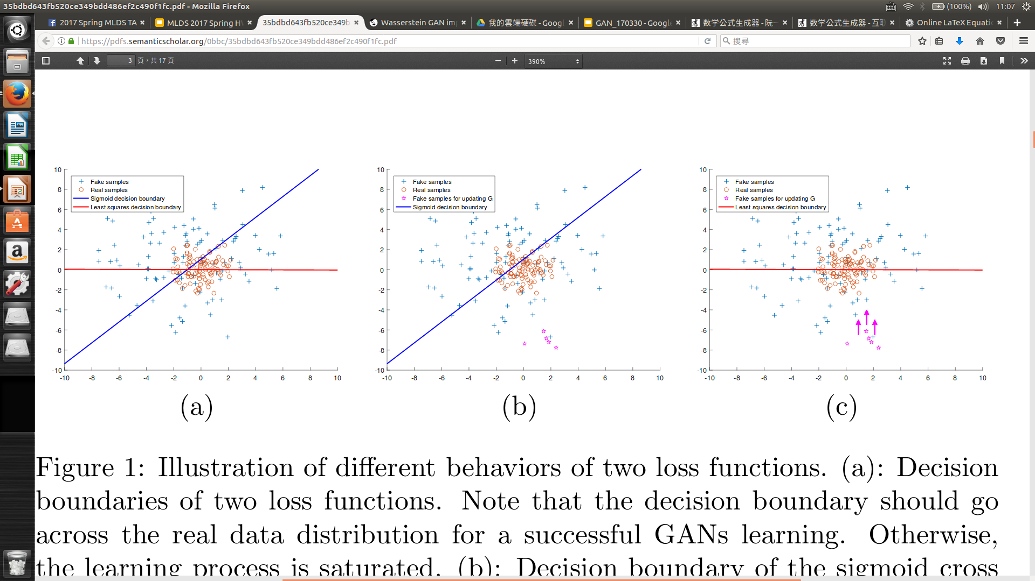
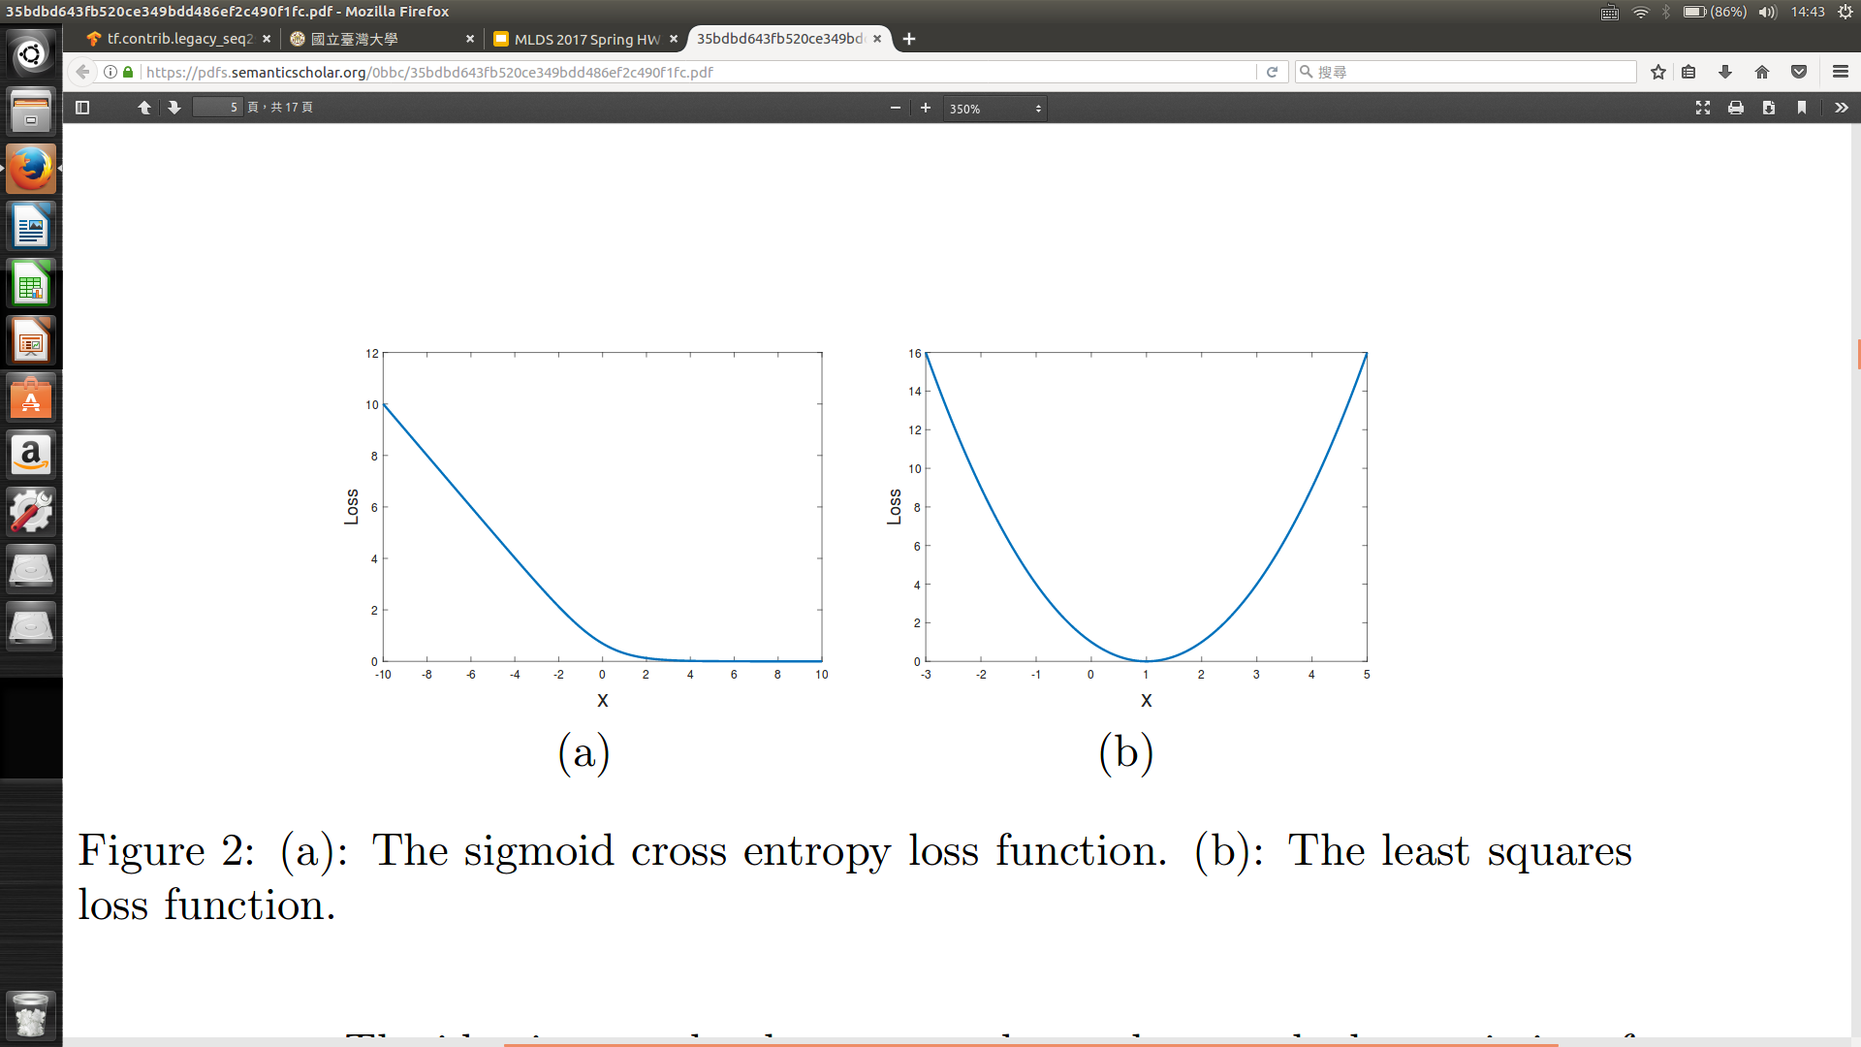
Least Squares GAN
Drag to decision boundary
-1
0
0
1
1
Saturate
ideal situation
D can’t distinguish real and fake samples

Slide 18
Least Squares GAN
For Discriminator
For Generator
1
0
1

Slide 19
Least Squares GAN
Implementation Notes :
Do not apply sigmoid at the output of D

Slide 20
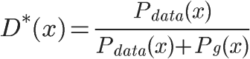
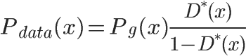
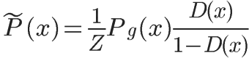
Boundary-Seeking GAN
Optimum Discriminator :
For imperfect discriminator :
Z : normalize term
Reference : Hjelm, R. Devon, et al. "Boundary-Seeking Generative Adversarial Networks." arXiv preprint arXiv:1702.08431 (2017).

Slide 21

Boundary-Seeking GAN
For Generator
Only change the loss function of G

Slide 22
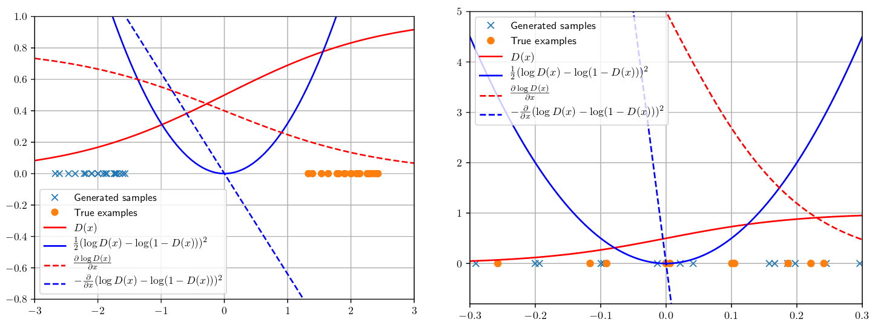
Boundary-Seeking GAN
move beyond the true sample
move toward decision boundary

Slide 23
Submission and Grading

Slide 24

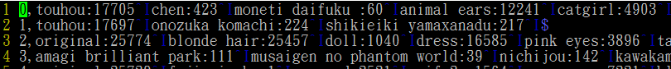
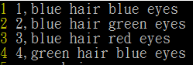
Homework 3 package
Anime Dataset:
training data: 33.4k (image, tags) pair
faces/, tags.csv, sample_testing.txt
training tags file format
img_id <comma> tag1 <colon> #_post <tab> tag2 <colon> …
testing text file format
testing_text_id <comma> testing_text
testing text only includes ‘color hair’ and ‘color eyes’, only alphabetic char involved.
Data download link:
https://drive.google.com/open?id=0BwJmB7alR-AvMHEtczZZN0EtdzQ
If you want to do something cool beyond generating faces, mail us. We will give you original images
blue eyes
red hair
short hair
tags.csv
sample testing_text.txt

Slide 25
Submission
Only Python with Tensorflow r1.0 for GAN
You are allowed to use any tool to process text
You are allowed to use any data you collect
Deadline: 5/25(Thu.) 23:59:59 (UTC+8)
MLDS2017/hw3 should contain following files
run.sh train.py, (pre-)trained_model, generate.py, samples/, report.pdf
If some files are too big, upload to your cloud and download them when running your run.sh
TAs will run your run.sh to generate images given a text
bash run.sh [testing_text.txt]
run.sh must output in 10 minutes.

Slide 26
Submission on Github
Only one branch master is needed
master stores the model by using GAN structure
Remember to put your pre-trained models or download scripts so that we can run your code successfully

Slide 27
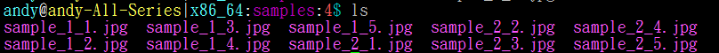
Output Format Requirement
The generated images should be in Directory samples/
make sure it’s empty before we run your code
Each generated image must be 64 x 64 in size
please resize all training images to 64 x 64 before training the model
For each input text, you must generate 5 images
Generated img should be named as “sample_(testing_text_id)_(sample_id).jpg”
Example:

Slide 28
組別互評
We will put your generated images in the grading platform
Link will be sent to your mail after HW deadline
Answer 2 scores for each image
How the image fits the text
How the image looks real
Scores should be integer from 1 to 5
1 to 5 corressponding to (super bad, bad, average, good, super good)
You may score your results, so be fair when your are scoring :)

Slide 29
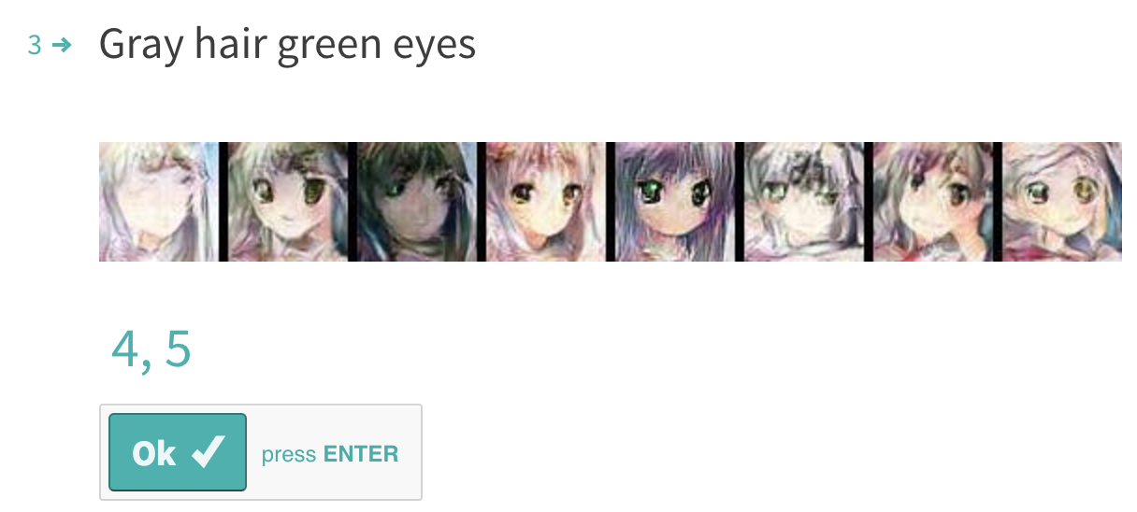
組別互評
Separate scores with a comma (score for matching text, score for reality)
Example:

Slide 30
What report should cover?
Environment (1%)
Ex. OS, CPU, GPU, Memory, libraries you used and version, etc.
Model description(3%)
Must include model strucuture, objective function for G and D
How do you improve your performance (5%)
Experiment settings and observation (5%)
Team division (1%)
No more than 5 pages
Please written in Chinese (unless you don’t know how to type Chinese)

Slide 31
Grading Policy (20%)
Wrong output format will not be graded
Report (10%)
Code (5%)
You will be scored only if you use GAN and output results in 10 minutes
Baseline
組別互評 (5%)
Bonus
組別互評 top 3 (5%, 3%, 2%)
Generate images beyond faces and show results in report (10%)

Slide 32
Other Policy
Late policy: 30% off per day late afterwards. [Delay form will be announced afterwards]
No plagiarism is allowed.

